Slide 1
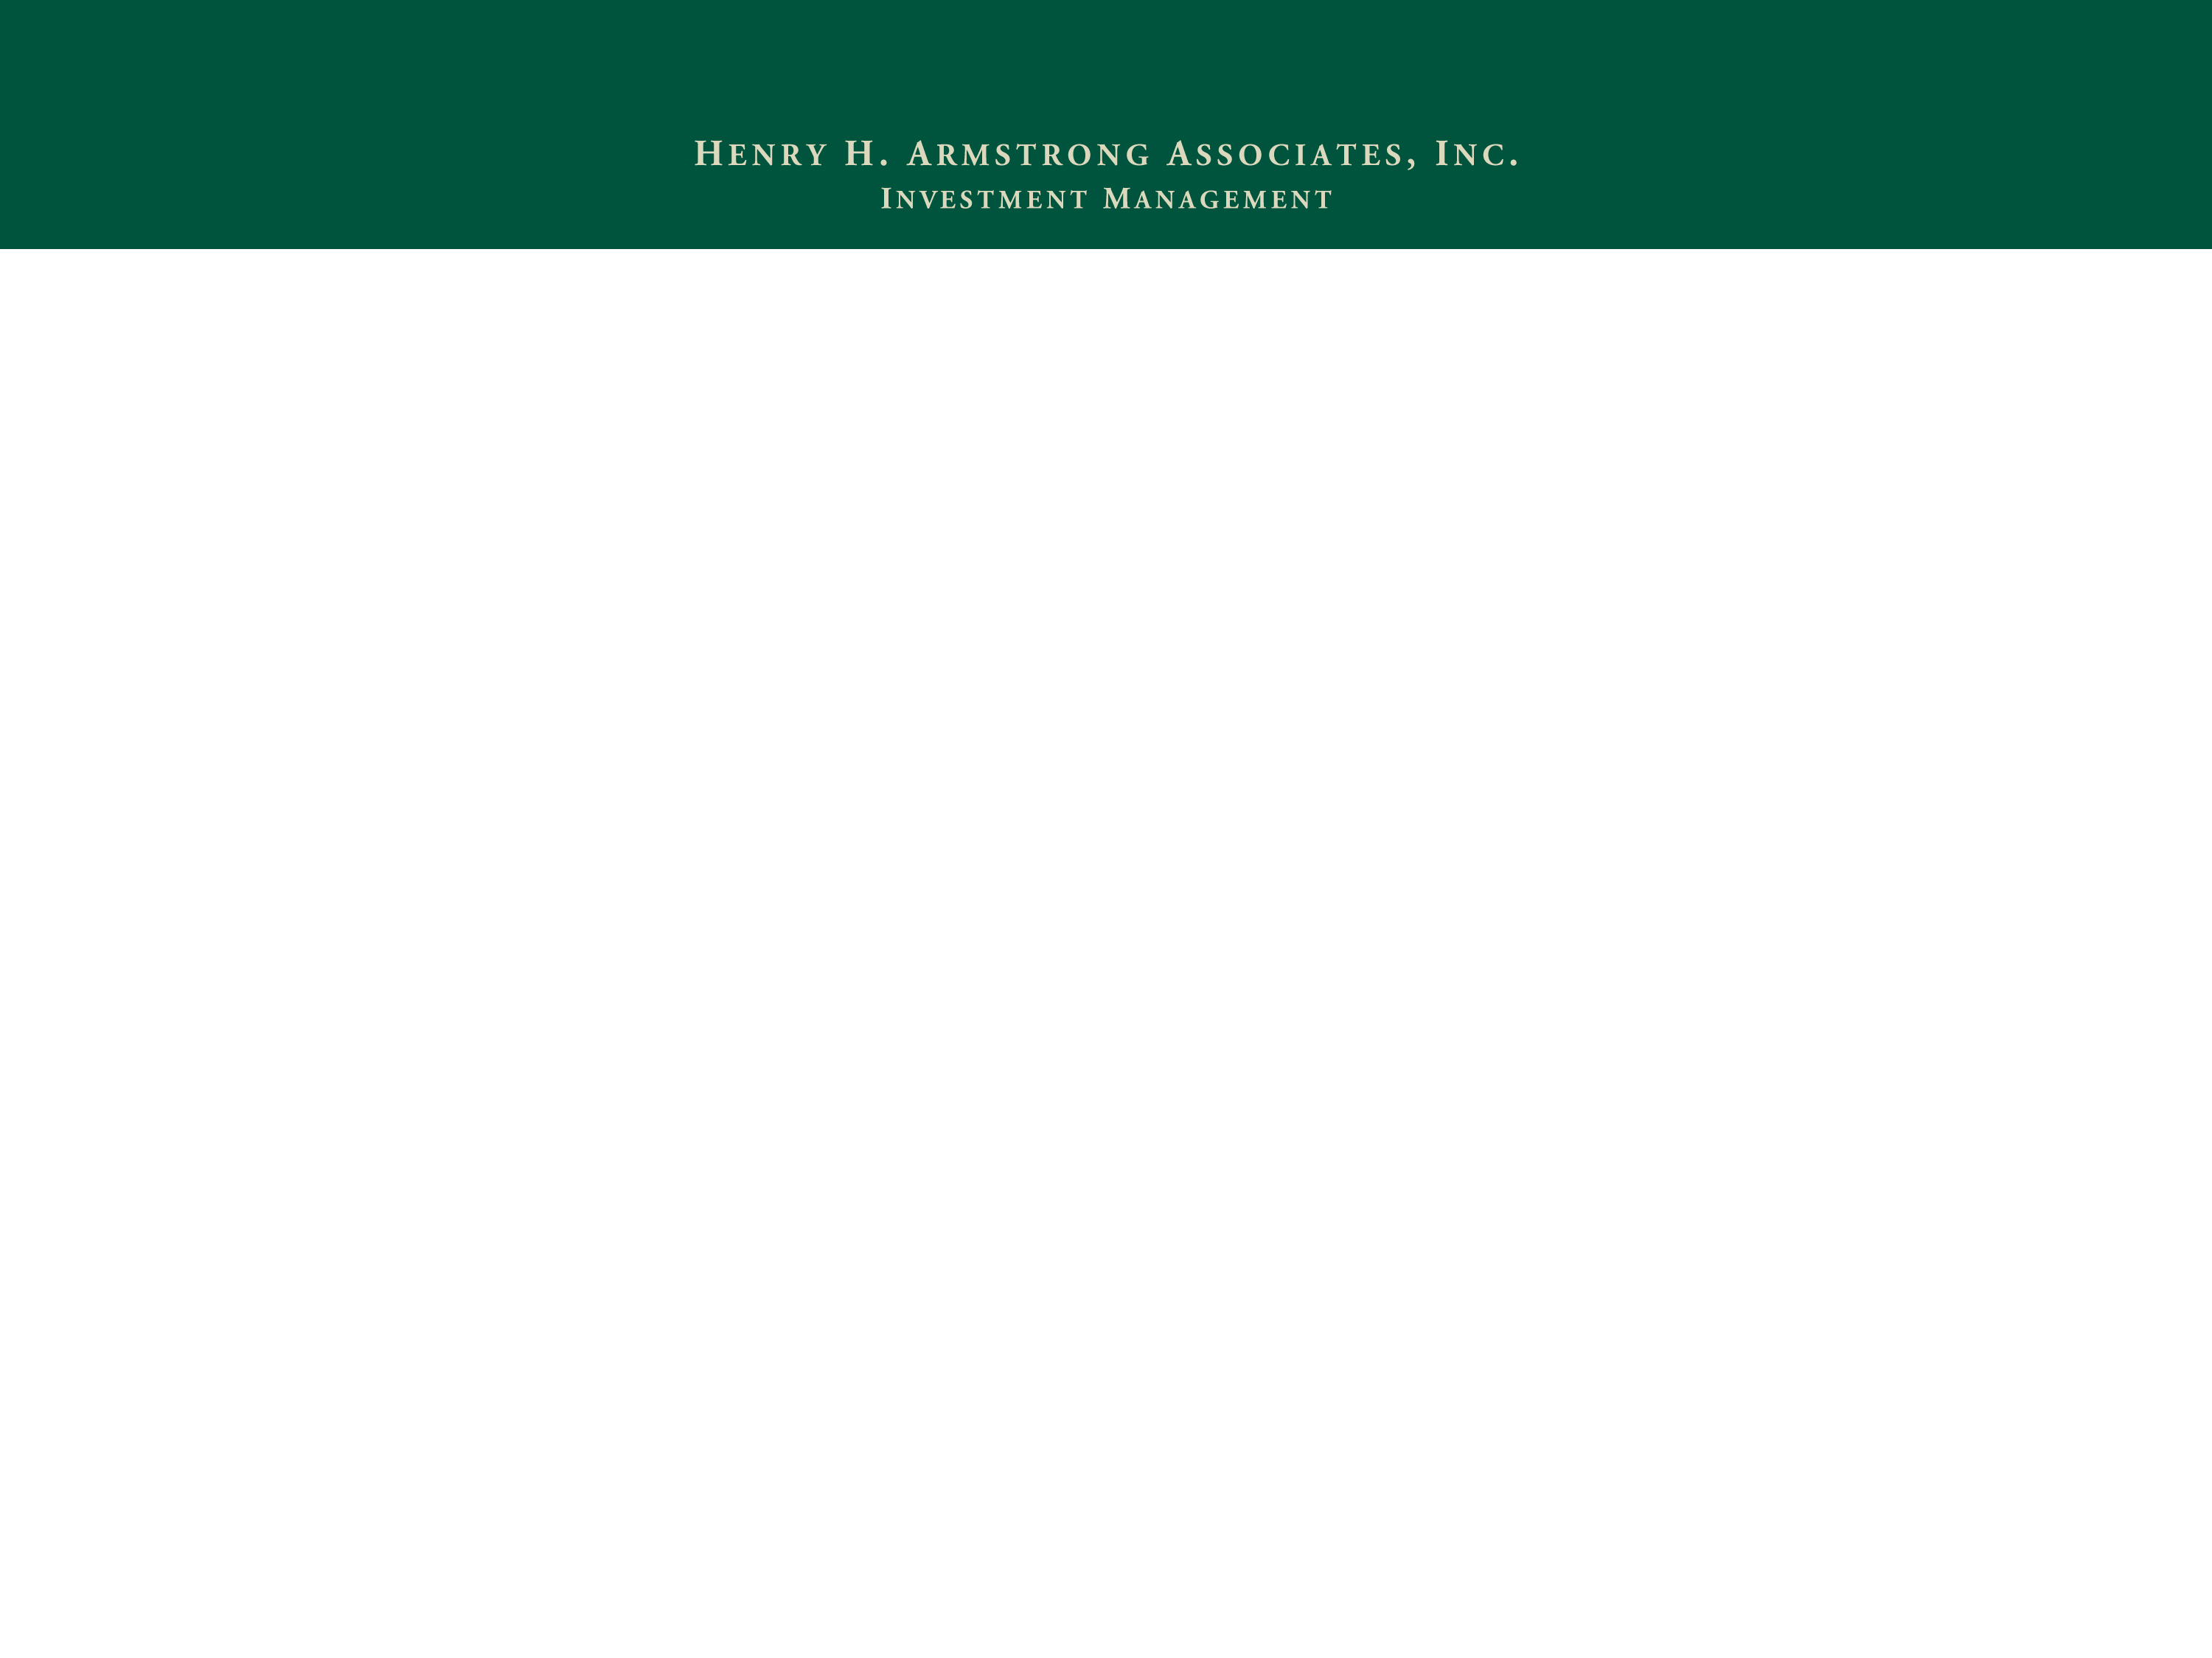
The Ins and Outs of IRAs: What Every HNW Advisor Should Know Pittsburgh Planned Giving Council March 22, 2022
Peter D. Eberhart, JD, CFP®
Managing Director
Henry H. Armstrong Associates, Inc
412.471.9550
pete@henryarmstrong.com

Slide 2
AGENDA
What is an IRA
Contribution rules
Taxation of contributions
Taxation of gains/income
Distribution rules
Required distributions
Taxation of distributions
Dying with an IRA
2

Slide 3
WHAT IS AN IRA?
IRAs are retirement accounts for individuals
IRAs provide tax-advantaged vehicles for individuals to save for retirement
Traditional IRA (26 US Code Sec 408)
Roth IRA (26 US Code Sec. 408A)
Section 408 authorizes all varieties of IRAs, but we’ll focus only on traditional and Roth
3

Slide 4
WHAT ARE THE IRA CONTRIBUTION RULES?
Traditional IRA
2022 contribution amount: $6,000, $1,000 catch-up 50+
Phaseout begins at $68,000 (single)/$109,000 (joint)
Phaseout complete at $78,000 (single)/$129,000 (joint)
Roth IRA
2022 contribution amount: $6,000, $1,000 catch-up 50+
Phaseout begins at $129,000 (single)/$204,000 (joint)
Phaseout complete at $144,000 (single)/$214,000 (joint)
There is no income limit for Roth Conversions
4

Slide 5
NOTES ON CONTRIBUTION RULES
You must have earned income in order to contribute to an IRA, and your contribution can’t exceed your earnings - BUT a non-working spouse can contribute, even if no earnings
Consider types of earnings for a custodial IRA
If you don’t have a retirement plan at work, you can deduct full contribution regardless of income – same goes for your spouse
5

Slide 6
TAXATION OF IRA CONTRIBUTIONS
Traditional IRA - contributions are tax deductible, they are after-tax
Roth IRA – contributions are NOT tax deductible, they are pre-tax
You can always make a non-deductible contribution to a traditional IRA, but should you?
6

Slide 7
MATH ON NON-DEDUCTIBLE IRA CONTRIBUTIONS
Consider the recordkeeping burden, too!
7

Slide 8
CONVERSIONS
Roth IRA conversions are not subject to income limits
Converted amounts are subject to ordinary income tax unless they are after-tax contributions; can’t choose to convert only after-tax assets – conversions must be proportional mix of after-tax and pre-tax money. Should you convert?
Consider the “Backdoor Roth IRA”
8

Slide 9
TAXATION OF ASSETS IN IRA
Income and gains in an IRA are not taxed so long as they remain in the account
Losses in an IRA can’t be deducted against income – changed in 2018
What are the best investments for IRAs?
Stocks?
Bonds?
Annuities?
Used to be immediate “No”
New rules and types of annuities – Qualified Longevity Annuity Contract
That’s where the money is
9

Slide 10
TAXATION OF IRA DISTRIBUTIONS
Distributions from a traditional IRA are ordinary income
Distributions of after-tax/non-deductible contributions are tax-free
Distributions must be proportionate between after-tax and pre-tax money
Distributions from a Roth IRA are tax-free
10

Slide 11
IRA DISTRIBUTION RULES
Prior to age 59 ½, withdrawals from traditional IRA are
Subject to taxes
Subject to 10% penalty unless you meet an exception
11

Slide 12
IRA DISTRIBUTION RULES
Exceptions to 10% penalty
Medical expenses – expenses exceed 10% AGI
Health insurance premiums while unemployed
Permanent disability
Higher education expense – you, spouse, or child
Buy, build, or rebuild a home - $10,000, cumulative, first- time buyer
Substantially equal periodic payments – Sec. 72(t)
Fulfill an IRS levy
Called to active military duty – at least 180 days
Adopt a child
12

Slide 13
IRA DISTRIBUTION RULES
How to make penalty-free and tax-free distributions from Roth IRA prior to age 59 1/2
Exceptions from last page apply, but also must hold the account for 5+ years
Non-qualified Roth distribution will be subject to tax on earnings and 10% penalty
You can withdraw your Roth IRA contributions anytime, tax- and penalty-free
13

Slide 14
IRA DISTRIBUTION RULES
Distributions between age 59 ½ and 72
May withdraw from traditional IRA without penalty
May withdraw from Roth tax-free and penalty-free from Roth
Must meet the 5-year requirement
Non-qualified distribution will be subject to tax on earnings and 10% penalty
14

Slide 15
IRA DISTRIBUTION RULES
Qualified Charitable Distributions (“QCD”)
Must be 70 or older
Up to $100,000 annually
Must go directly to charity
Not included in AGI
Counts against RMD
Consider QCD vs. gift of appreciated stock
QCD likely better for standard deduction taxpayers
Gift of stock avoids realizing capital gain
15

Slide 16
IRA DISTRIBUTION RULES
60-Day Rollover
Tax free distribution if returned within 60 days
If not returned by 60th day, fully taxable
Can serve as tax-free short-term loan
16

Slide 17
IRA DISTRIBUTION RULES
Required Minimum Distributions (RMD)
There are no RMDs from a Roth IRA
RMDs from traditional IRA begin in the year the owner turns 72 – was 70 ½ prior to 1/1/2020
RMD amount calculated annually
Account balance as of prior year-end, divided by…
Life expectancy factor from IRS tables, usually Uniform Lifetime Table
Tables were updated for 2022
17

Slide 18
IRA DISTRIBUTION RULES
Required Minimum Distributions (RMD) - continued
Must take RMD by 12/31 each year, with one exception…
May take 1st RMD in by April 1 of the year after you turn 70 ½, but you’ll have to take two RMDs that year
QLAC – 25% of assets in deferred annuity
50% penalty on undistributed RMD
18

Slide 19
DYING WITH AN IRA
IRAs require a beneficiary designation
Most common are spouse, children, charity, or trust
Create separate accounts for all beneficiaries after owner’s passing by 12/31 of year after owner’s passing
19

Slide 20
DYING WITH AN IRA
IRAs require a beneficiary designation
Spousal rollover is available
Stretch IRA no longer available
Non-spouse beneficiary must withdraw all funds within 10 years of IRA owner’s passing
No annual required distribution during 10-year window
Opportunity for CRT planning
True for traditional and Roth IRAs
20

Slide 21
DYING WITH AN IRA
Exceptions to inherited IRA 10-year distribution rule
Surviving spouse
Disabled or chronically ill person
Minor child of owner
Person not more than 10 years younger than IRA owner
21

Slide 22
DYING WITH AN IRA
More on beneficiary designations
Owner’s estate is usually default beneficiary
Shares usually must be expressed as %
IRAs are non-probate assets passing outside the estate
Custom beneficiary designations require special care
Charities are often better beneficiaries of traditional IRAs than are individuals
22

Slide 23
THE MATH ON CHARITY AS BENEFICIARY
23

Slide 24
DYING WITH AN IRA
Some practical tips
Owner must take RMD in year of death – take RMDs early
Inherited IRAs must be created at current custodian
Be certain the beneficiary designations and beneficiary contact info are up to date!!!!
24

